Slide 1


PAY ROLL MANAGEMENT SYSTEM
PRESENTED BY
NEHA HENIN J & 23038117104822025

Slide 2

PRESENTATION OVERVIEW
Project description and analysis
Architecture diagram
Module description
SQL code
Output

Slide 3
PROJECT DESCRIPTION AND ANALYSIS
Automates Payroll Processing
Eliminates the need for manual salary calculations and record-keeping.
Comprehensive Employee Management
Stores employee details, salary structures, and job roles.
Accurate Salary Computation
Calculates gross salary, deductions, bonuses, and net salary.
Tax and Compliance Handling
Ensures compliance with tax regulations and legal requirements.
Leave ad Attendance Tracking
Integrates attendance data for precise payroll calculations.
Pay Slip Generation
Creates detailed pay slips with salary breakdown and deductions.

Slide 4
PROJECT DESCRIPTION AND ANALYSIS
Multi-Level Access Control
Restricts data access based on user roles (HR, Admin, Employee).
Secure Data Storage
Ensures payroll data is securely stored and encrypted.
User-Friendly Interface:
Designed for ease of use by HR and payroll teams.
Audit and Record Maintenance:
Maintains historical payroll records for audits and compliance checks.
Cost-Effective:
Reduces administrative costs associated with payroll management.
Real-Time Updates:
Updates employee records and salary structures dynamically..

Slide 5
ARCHITECTURE DIAGRAM
Database Management
START
User Interface
Business Logic Layer
Salary Computation
Tax & Compliance Management
Employee Management
External Interfaces
Report & Analytics Module
Attendance & Leave Tracking
Stores employee details (name, ID, department, salary structure).
Automates salary calculation based on attendance, deductions, and bonuses.
Pay Slip Generation
STOP

Slide 6
MODULE DESCRIPTION
1. Employee Management
                Stores employee details (name, ID, department, salary structure).
              Manages new hires, promotions, and terminations.
2. Attendance & Leave Tracking
Records employee working days, overtime, and leave requests.
Integrates with biometric or manual attendance systems.
3. Salary Computation
Automates salary calculation based on attendance, deductions, and bonuses.
Computes tax and insurance deductions as per regulations.

Slide 7
MODULE DESCRIPTION
4. Pay Slip Generation
Generates digital and printable pay slips for employees.
Stores payroll history for future reference.
5. Tax & Compliance Management
Calculates applicable taxes and deductions for each employee.
Ensures compliance with government payroll regulations.
6. Report & Analytics Module
Generates payroll summary reports for HR and management.
Provides analytics on salary trends, overtime expenses, and employee costs.

Slide 8
SQL CODE
CREATE TABLE users ( id INT AUTO_INCREMENT PRIMARY KEY, username VARCHAR(50) NOT NULL UNIQUE, email VARCHAR(100), password VARCHAR(255) NOT NULL );
CREATE TABLE employees ( id INT AUTO_INCREMENT PRIMARY KEY, name VARCHAR(100), position VARCHAR(100), salary DECIMAL(10,2) );
CREATE TABLE payroll ( id INT AUTO_INCREMENT PRIMARY KEY, employee_id INT, pay_month VARCHAR(20), amount DECIMAL(10,2), FOREIGN KEY (employee_id) REFERENCES employees(id) );

Slide 9
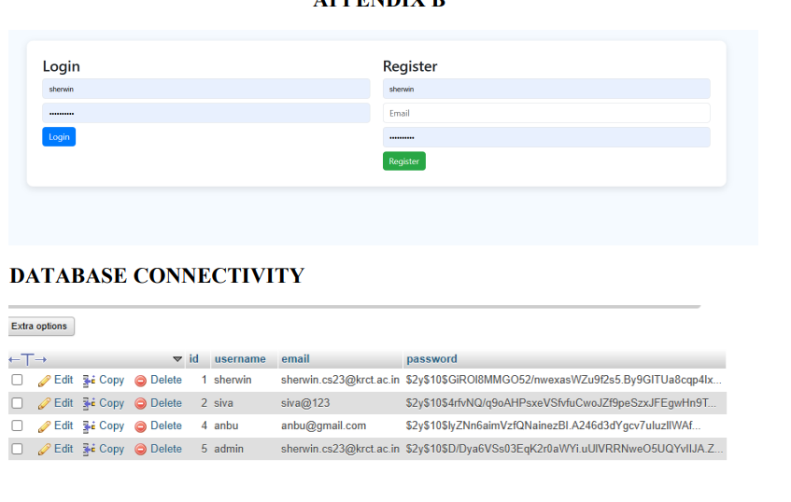
OUTPUT

Slide 10
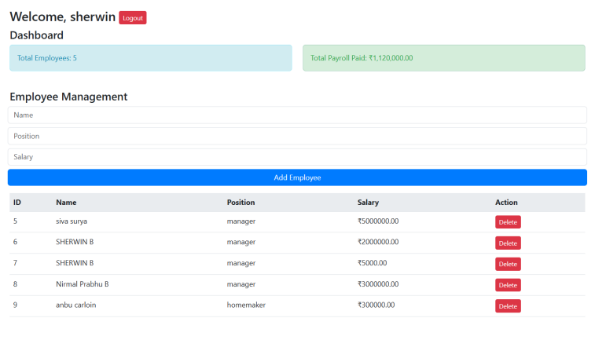
OUTPUT

Slide 11
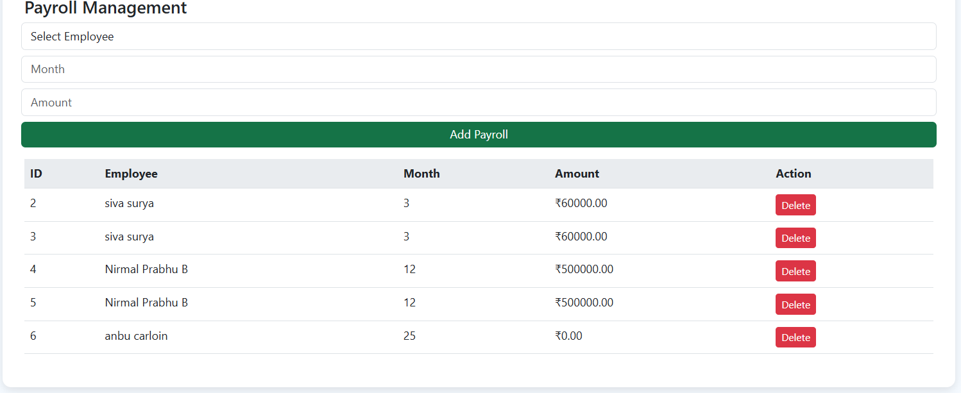
OUTPUT

Slide 12
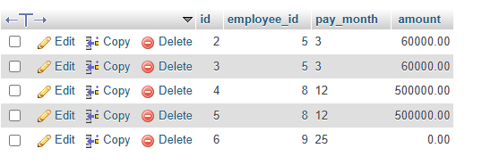
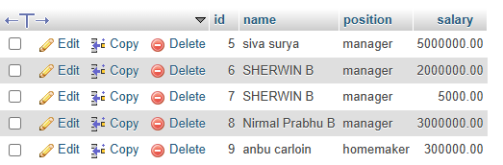
OUTPUT

Slide 13
THANK YOU

